Slide 1
WEB CRAWLING & ANALYSIS
MSIS 615 Business Programming (Fall 21)
Final Project A
by: Alisha Warke
CARVANA

Slide 2
OVERVIEW
Carvana Website Elements
Web Crawling
Database
Descriptive Analysis
Visualization
Linear Regression

Slide 3
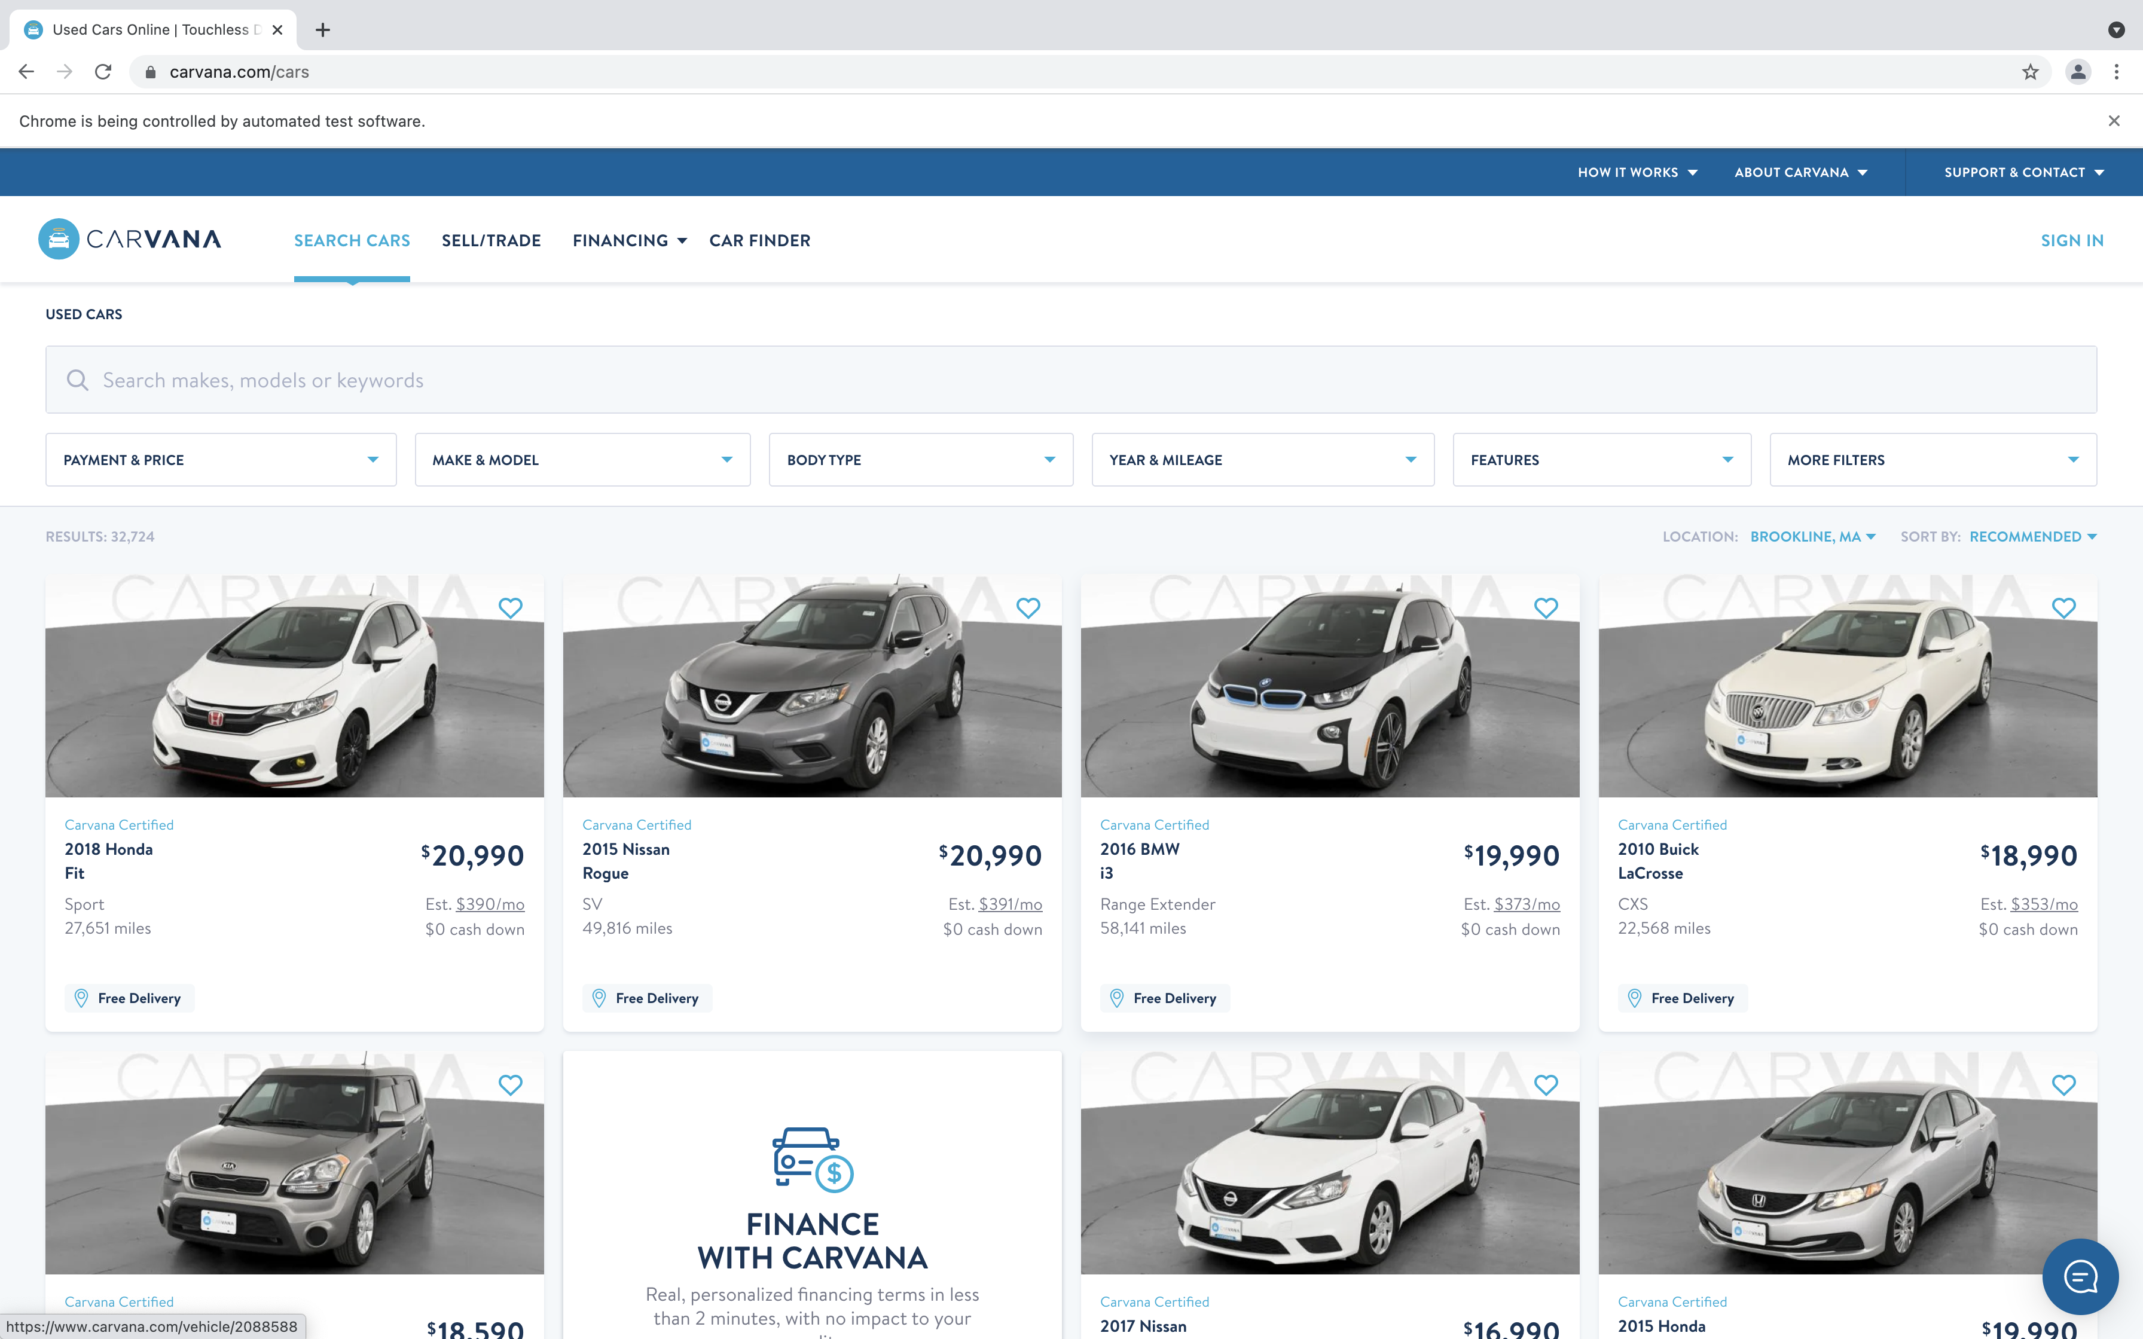
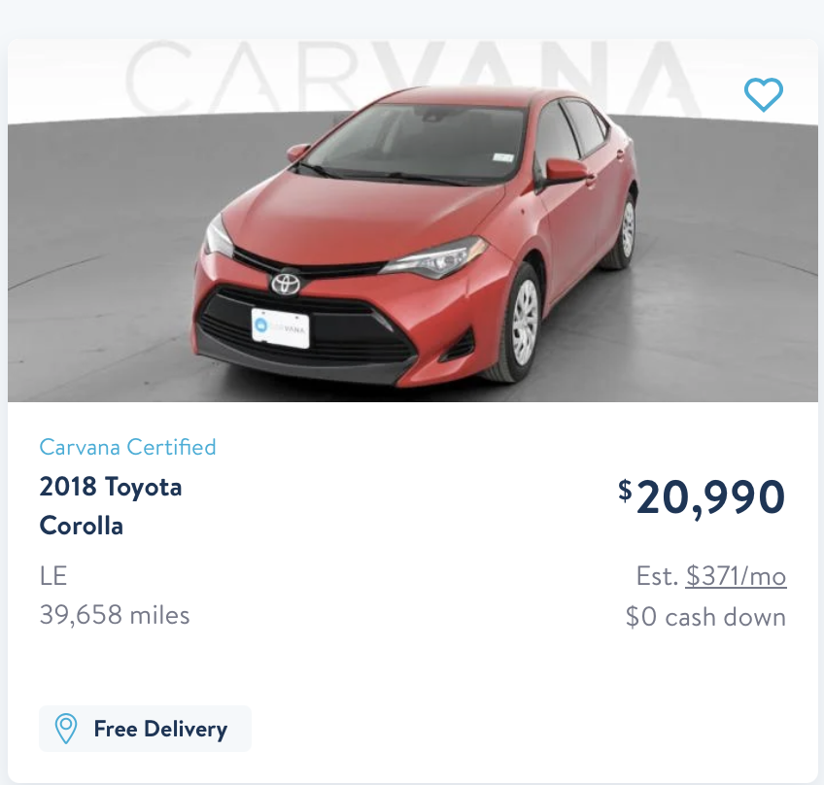
CARVANA WEBSITE

Slide 4
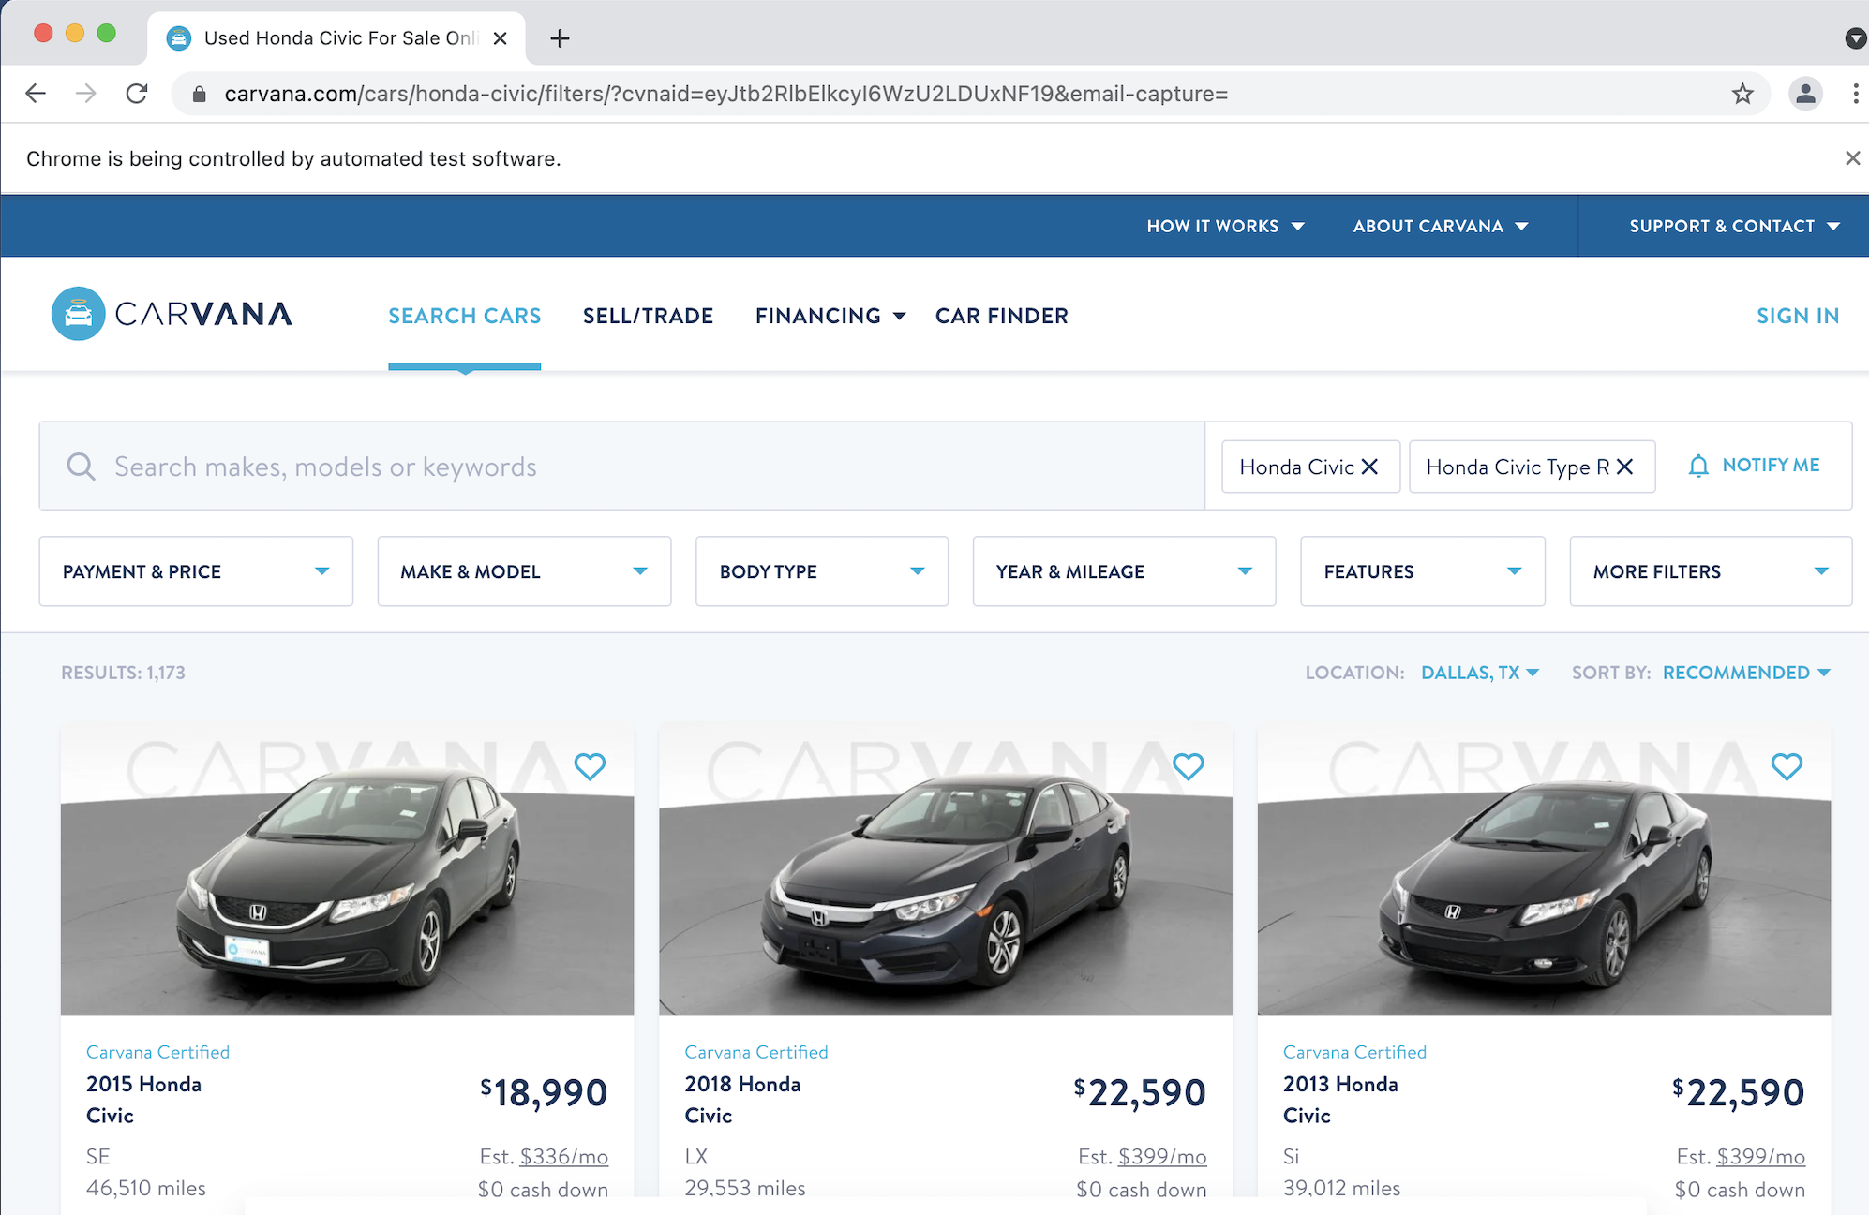
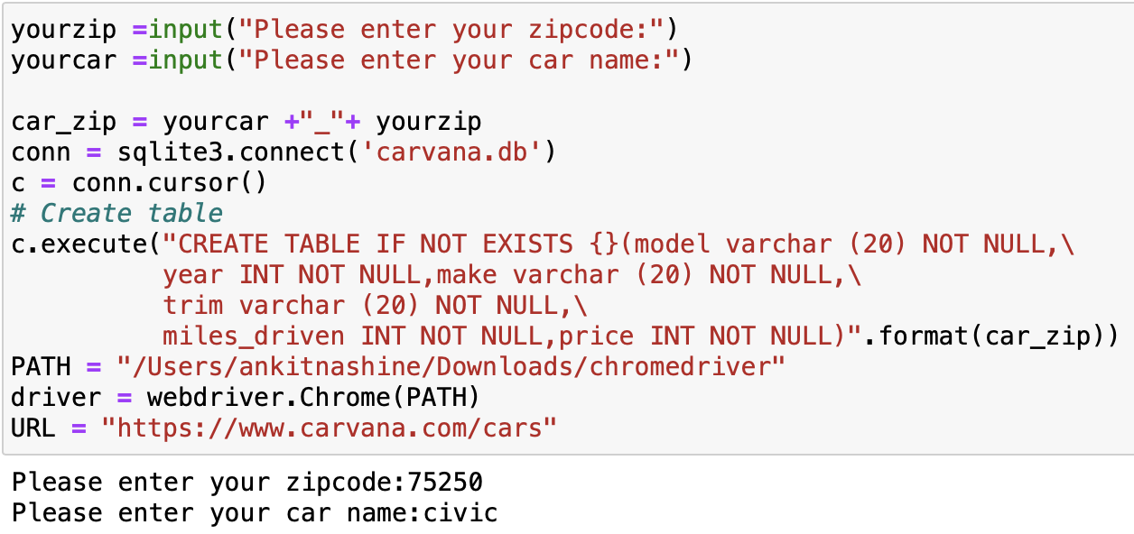
WEB CRAWLING

Slide 5
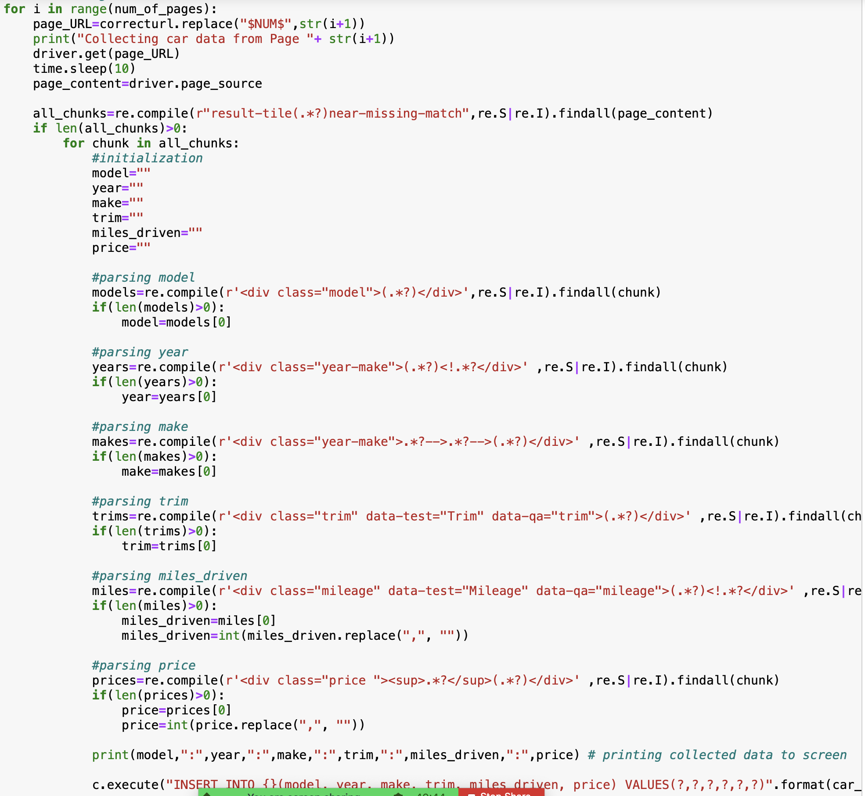
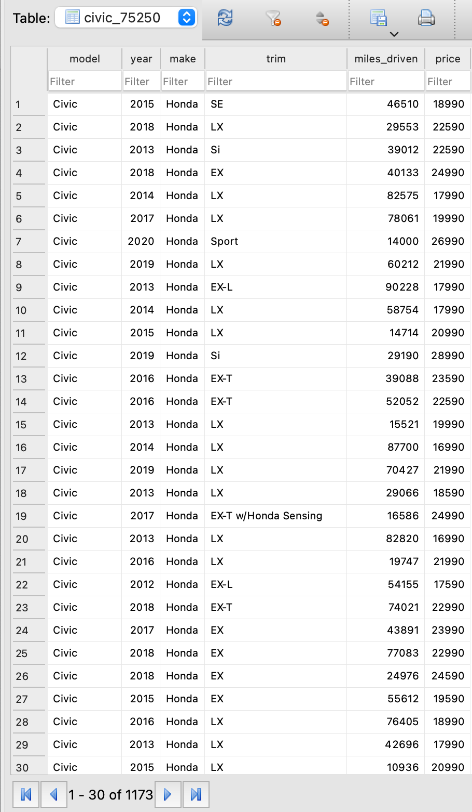
FROM WEBSITE TO DATABASE

Slide 6
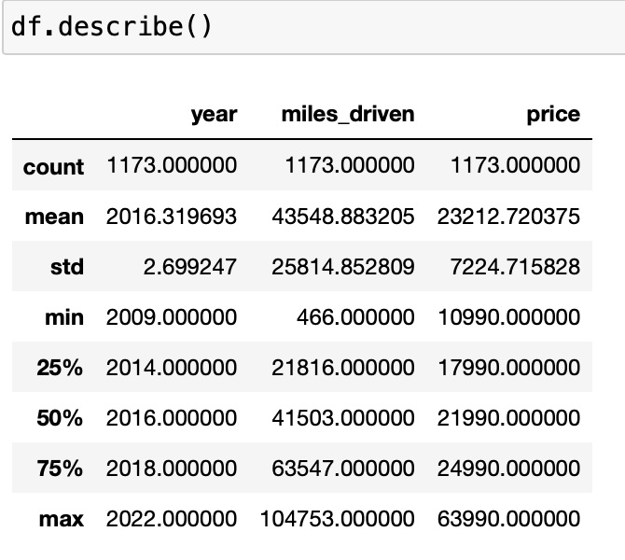
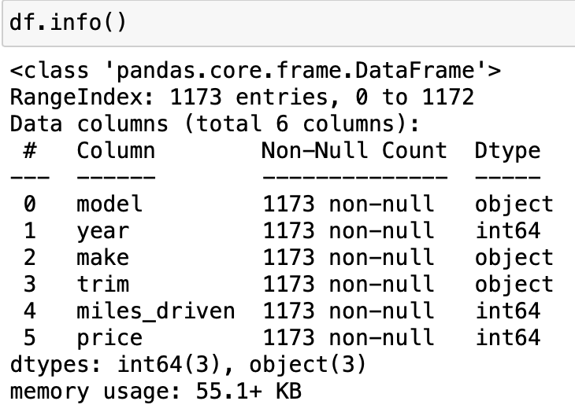
DESCRIPTIVE ANALYSIS

Slide 7
VISUALIZATION

Slide 8
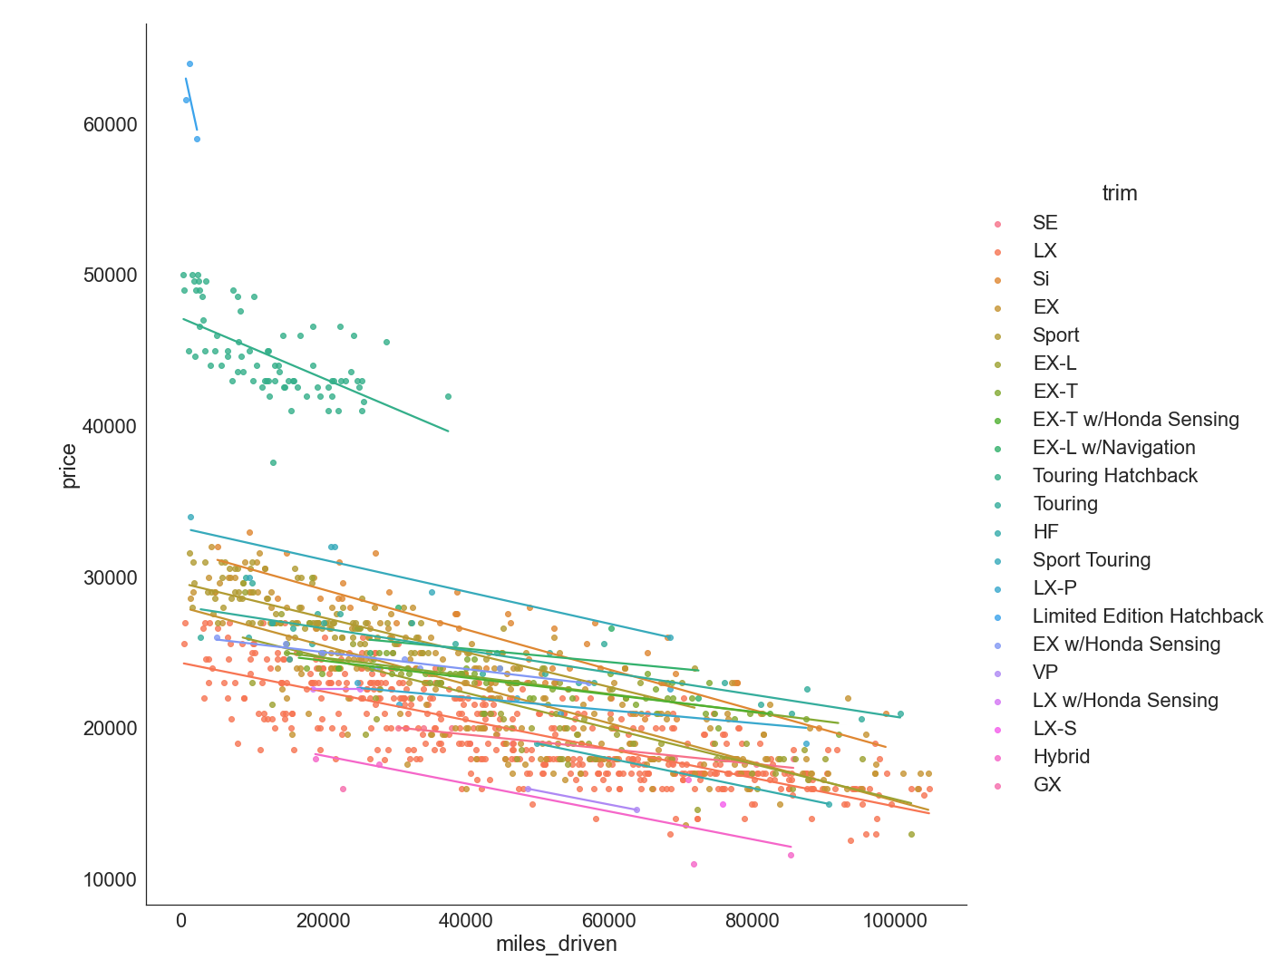
Regression Plot

Slide 9
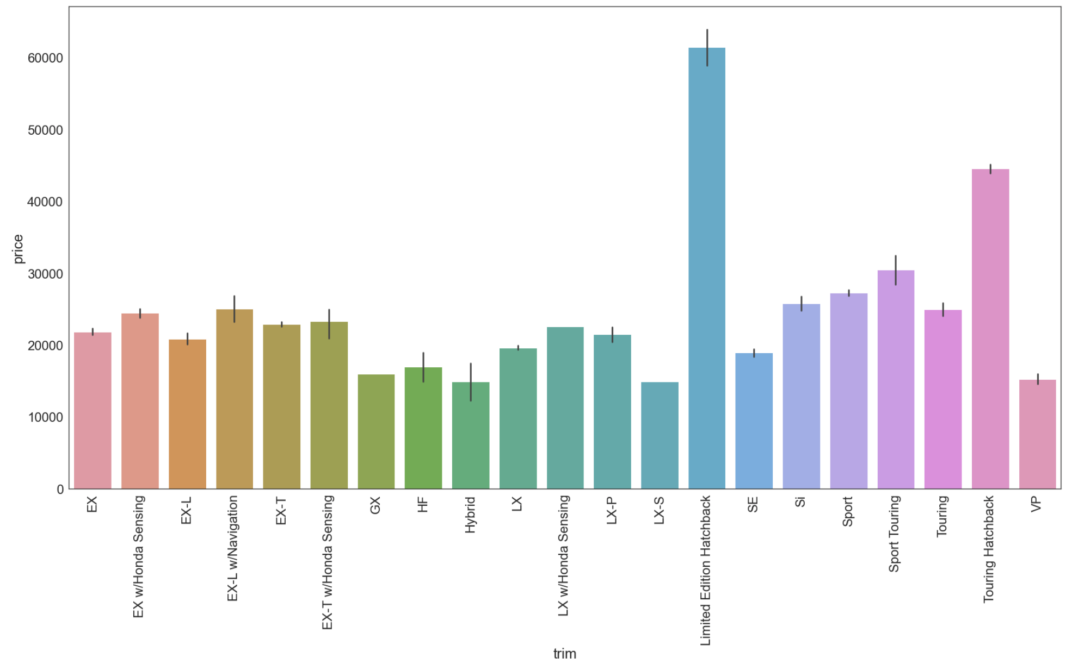
Bar Plot (Price VS Trim)

Slide 10
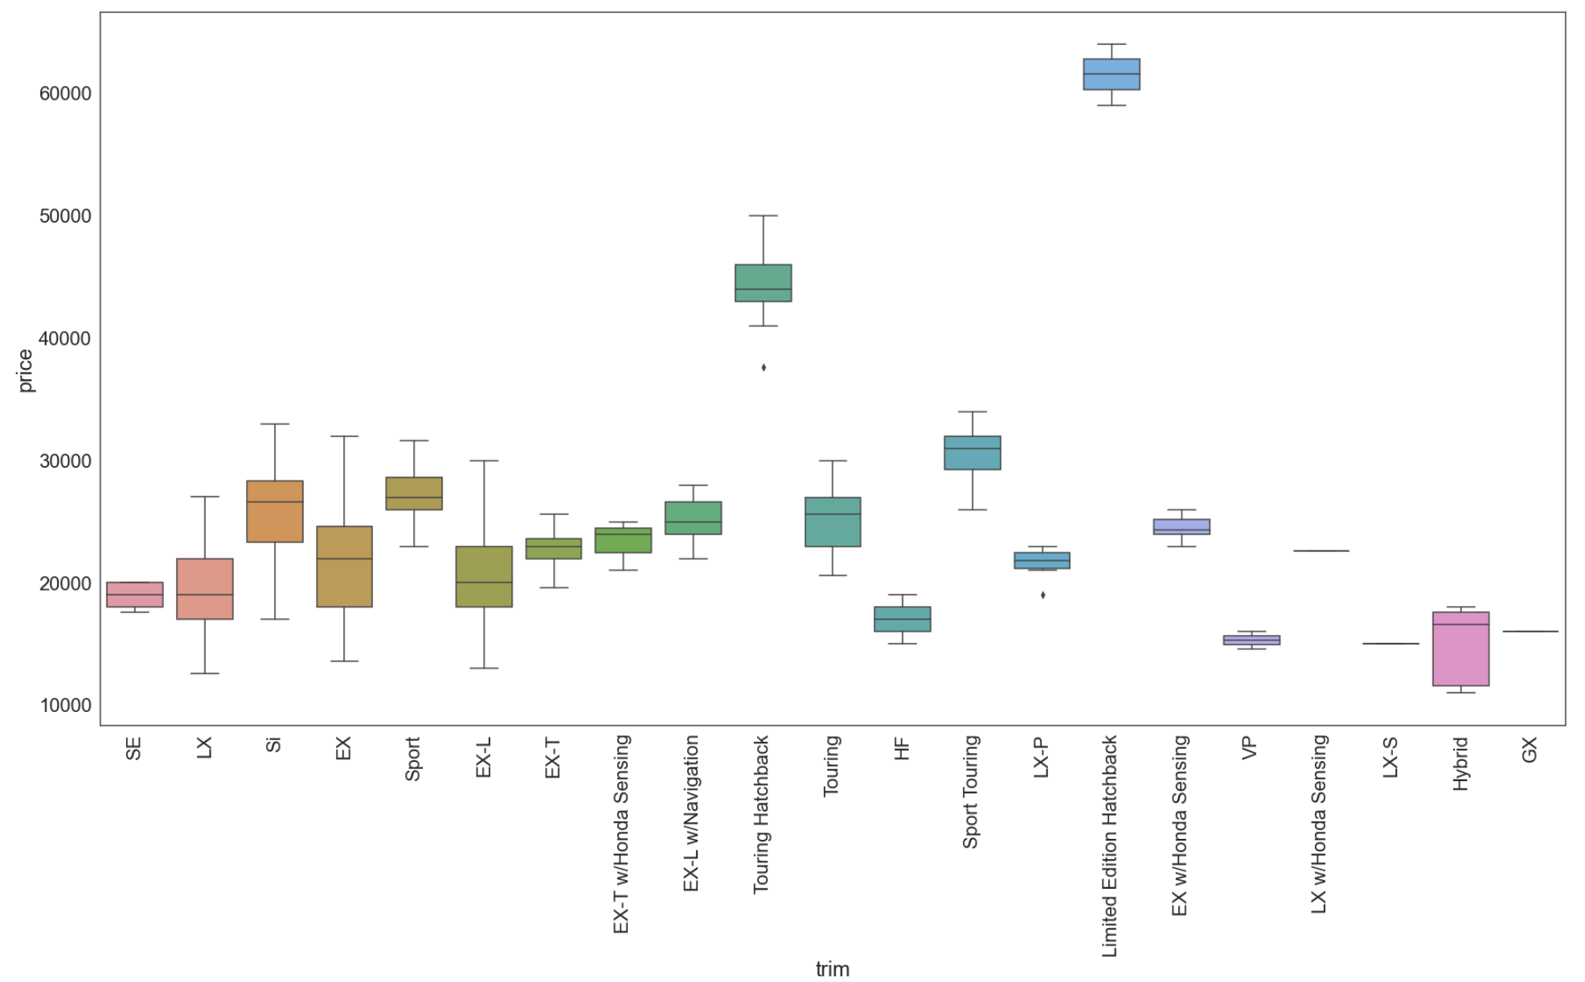
Box Plot (Price VS Trim)

Slide 11
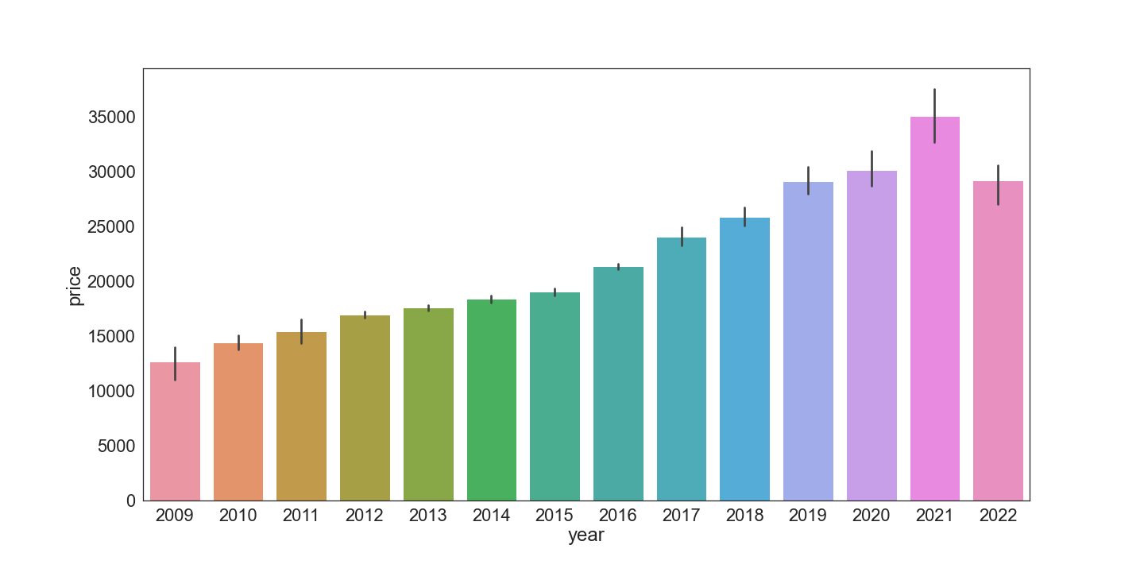
Bar Plot (Price VS Year)

Slide 12
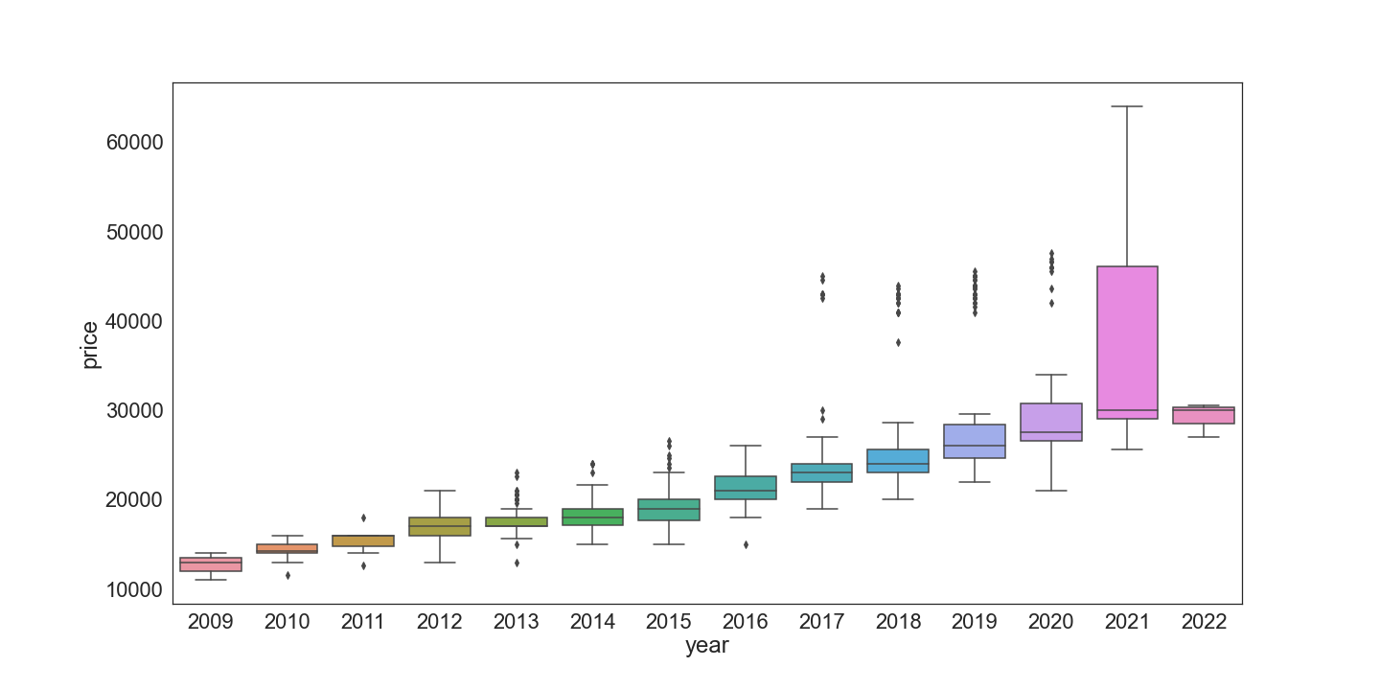
Box Plot (Price VS Year)

Slide 13
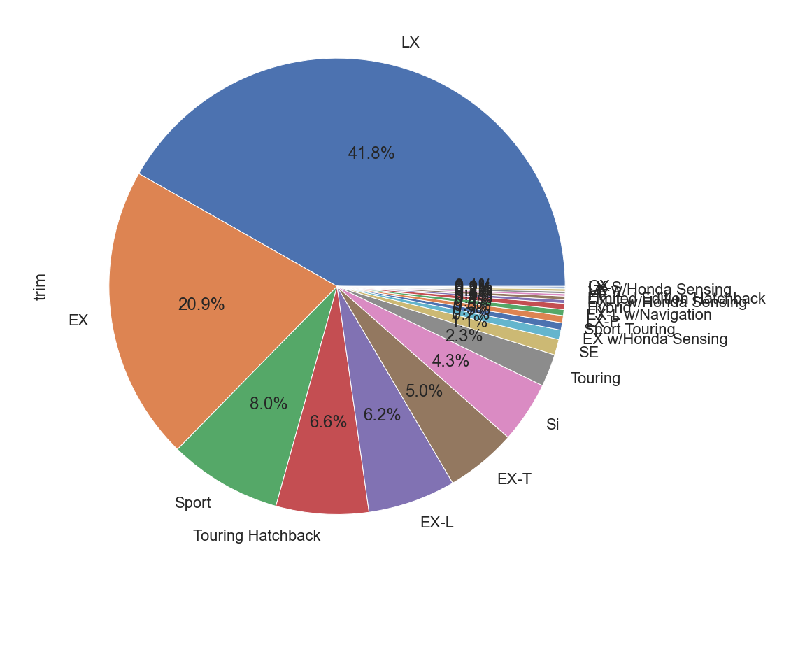
Pie Chart for Trim

Slide 14
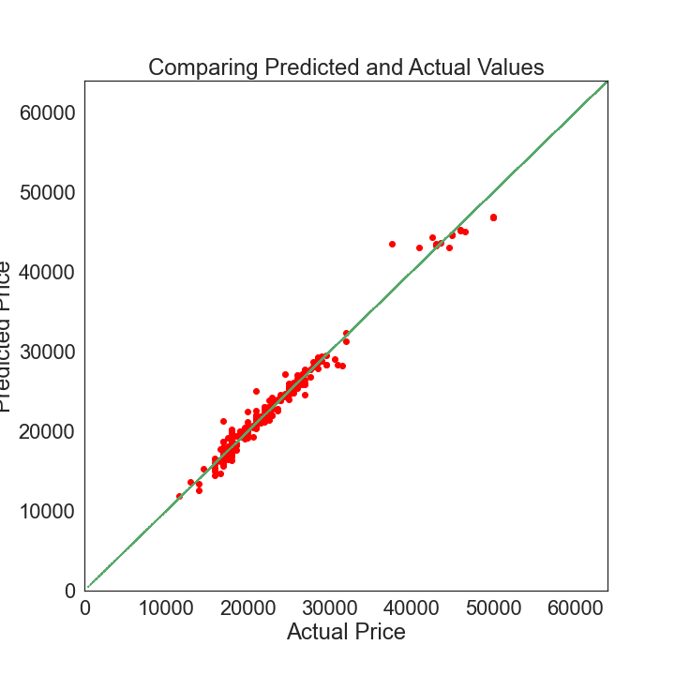
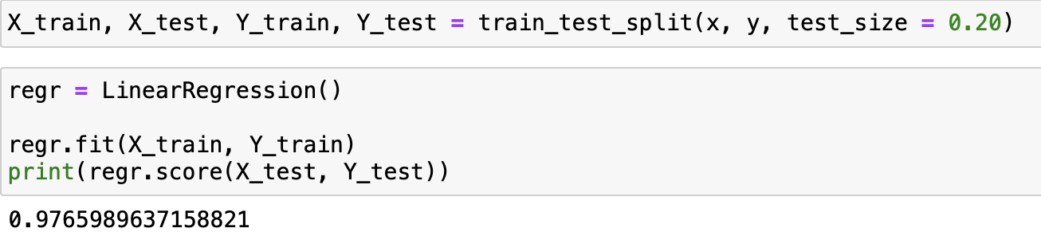
LINEAR REGRESSION ANALYSIS

Slide 15
THANK YOU

